Slide 1
Metaverse for Healthcare: A Survey on Potential
Applications, Challenges and Future Directions
Syed Muhayminul Islam
Roll 2671512

Slide 2
About
Author: Mamoun Alazab,Reddy Gadekallu
Publisher: IEEE Access
Copyright Date: 2023

Slide 3

Summary
Digital technology is improving healthcare services. The Metaverse allows doctors and patients to interact in a virtual environment using AI, VR, and smart devices. It helps provide better, personalized, and lower-cost treatment. The article explains its technologies, applications, challenges, and future possibilities to improve healthcare systems.

Slide 4
State of the Art: Digital and Smart Healthcare Technologies
Sensors
Big Data
Artificial Intelligence (AI)
Wireless Communication Networks
Internet of Things (IoT)
Edge Computing
Cloud Computing
Immersive Technology (AR/VR)

Slide 5
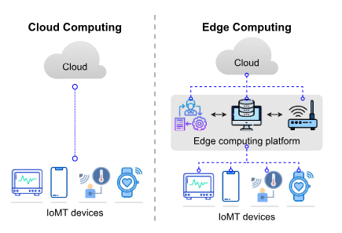

Slide 6
Potential Applications of the Metaverse for Healthcare
Medical Training and Education
Virtual Consultation
Surgery
Patient Monitoring
Remote Healthcare
Medical Diagnosis
Patient Counselling
Medical Research

Slide 7
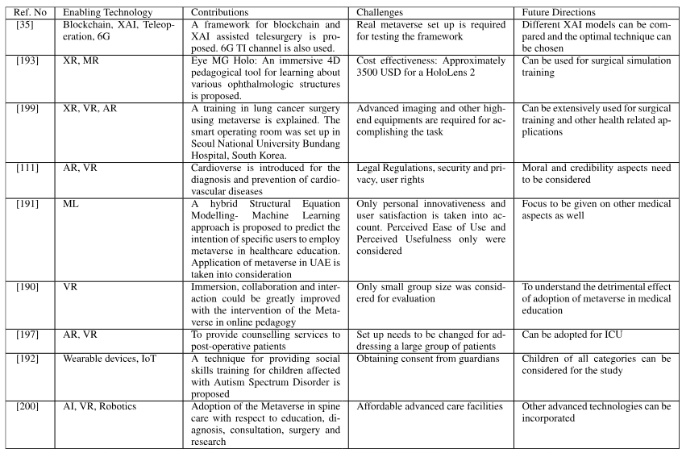

Slide 8
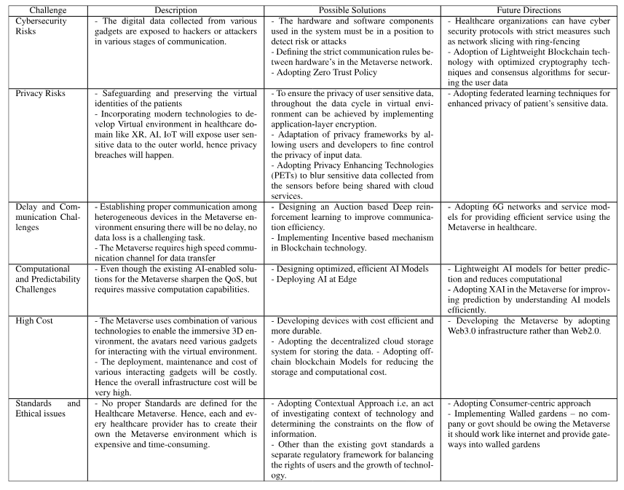

Slide 9
Thank You

